Slide 1
IBM University Engagement Project Submission
“Exploring the Power of Agentic AI with IBM Granite and IBM Bob”

Slide 2

Project Tile – [Agentic Career Counseling Companion]
Domain of Project – [Education]
Student Name | Recent Passport Photo | Email ID | Mobile number [WhatsApp]
Bhagyalaxmi Gudimella |  | 325bhagyalaxmi@gmail.com | 9869157606
Recommended font style and size: Font Style: Arial Font Size (Heading): 28
Font Size (Content): 20

Slide 3
Problem Statement -
Problem Statement – Agentic Career Counseling Companion The Challenge – Students often struggle to make informed career decisions due to fragmented access to guidance, limited self-awareness of academic strengths, and rapidly evolving industry landscapes. Traditional counseling methods lack personalization and scalability, leading to missed opportunities and career mismatches. The challenge is to develop an intelligent, autonomous agent that continuously monitors student performance, evolving interests, and real-time labor market trends to deliver tailored career pathway suggestions. This would empower students to make confident, future-ready decisions with minimal dependency on manual intervention.
The Objective
Build an AI-powered Agentic Career Counseling Companion that delivers personalized career guidance and future-ready recommendations for students, graduates, and career counselors. The solution should:
Personalized Career Paths – Recommend careers based on skills, academic performance, interests, and goals.
Career Data RAG Retrieval -- Fetch job trends, required skills, and certification details from reliable sources..
Skill Gap Analysis – Suggest courses, projects, and internships to improve career readiness.
Multi-Agent System –
Career Knowledge Agent (fetches Career and job data)
Career Recommendation Agent (suggests personalized career paths)
Skill Developement Agent (recommends learning resources)
Visualization Dashboard – Show career readiness, skill progress, and recommended roadmap.

Slide 4
Proposed Solution -
Proposed Solution: AI-Powered Agentic Career Counseling Companion
The proposed solution is a multi-agent AI-powered Career Counseling Companion built using IBM Bob, IBM watsonx.ai, and Granite Models to provide personalized, real-time career guidance. The system addresses challenges in career planning, skill development, and job readiness through an intelligent, modular architecture.
At its core, the solution uses a Retrieval-Augmented Generation (RAG) pipeline to fetch accurate career information from trusted sources such as job portals, industry reports, and learning platforms. This data is stored in a vector database, enabling the system to retrieve and summarize career trends, required skills, certifications, and job opportunities using Granite models.
The system consists of four key agents:
Career Knowledge Agent retrieves and summarizes career and industry information using RAG.
Career Recommendation Agent suggests personalized career paths based on academic performance, skills, interests, and goals.
Skill Development Agent identifies skill gaps and recommends courses, certifications, projects, and internships.
Progress Tracking Agent monitors student achievements and provides continuous feedback with updated career recommendations.
The solution includes a user-friendly dashboard (built with Streamlit or React) that visualizes skill progress, career readiness, recommended learning roadmaps, and industry trends.
IBM Bob orchestrates agent workflows, while watsonx.ai enables scalable model deployment, embeddings, and AI governance. Granite Models power reasoning, summarization, and personalized career recommendations.
Overall, this solution delivers an end-to-end intelligent career counseling assistant that helps students make informed, future-ready career decisions with personalized guidance and real-time insights.

Slide 5
Technology Used
IBM Bob platform -For designing and orchestrating multi-agent workflows visually
IBM Grainte model - for eg – ibm-granite-3-2-8b – For natural language understanding, reasoning, and personalization
IBM Cloud – It provides the infrastructure to build, deploy, and scale the Nutrition Agent efficiently. IBM Cloud enables a reliable, secure, and scalable environment for deploying the Nutrition Agent.
RAG– RAG to fetch real data first, then generate intelligent answers, making the Nutrition Agent more trustworthy and effective.
IBM Watsonx.ai - For model deployment, embeddings, and AI governance
Vector Database (FAISS/Chroma) – For RAG-based nutritional data retrieval

Slide 6
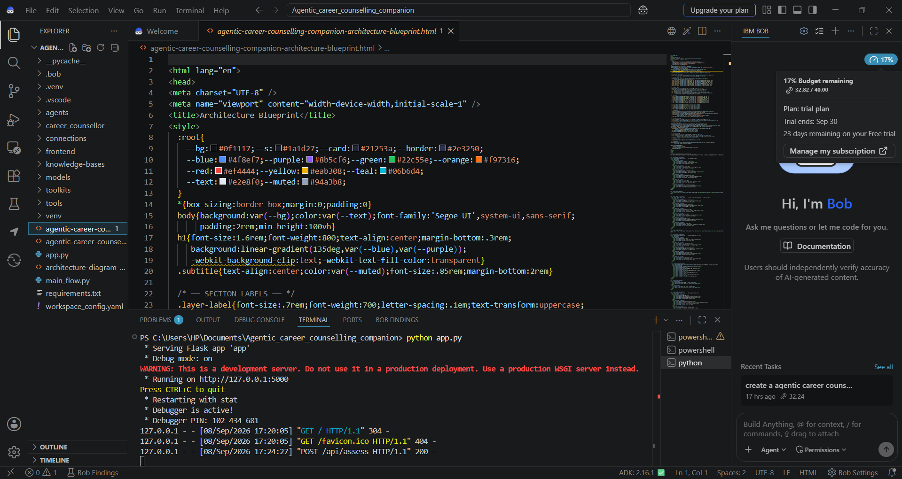
Required Files created using IBM bob -

Slide 7
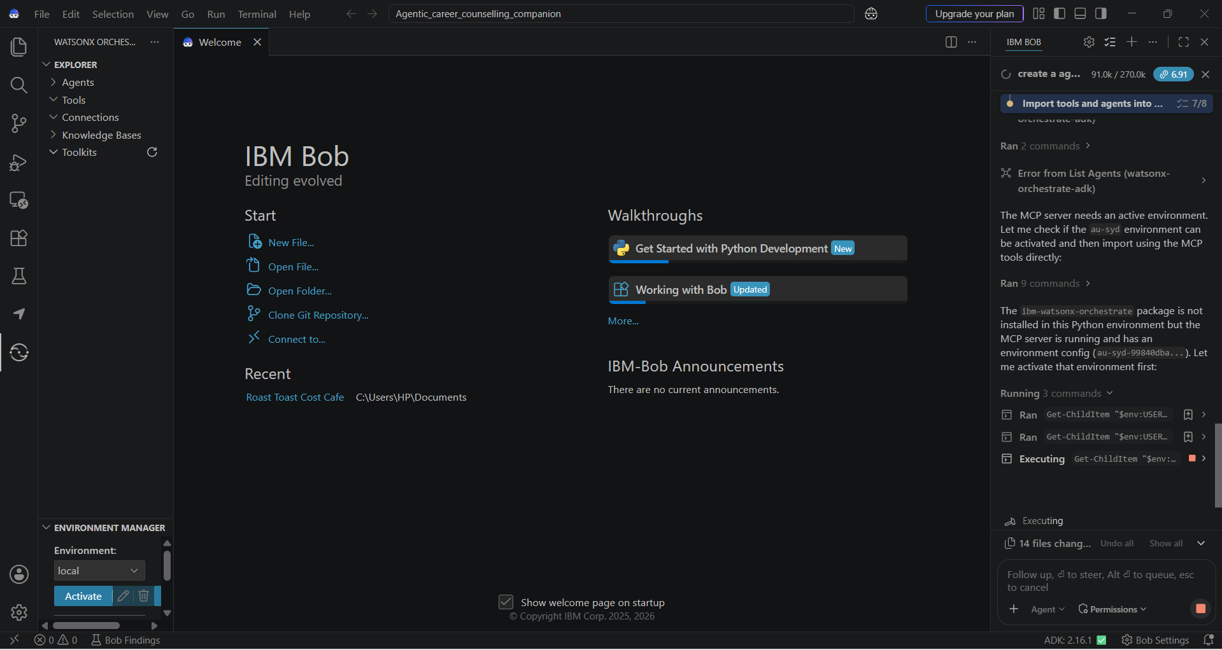
IBM Bob Screenshots:

Slide 8
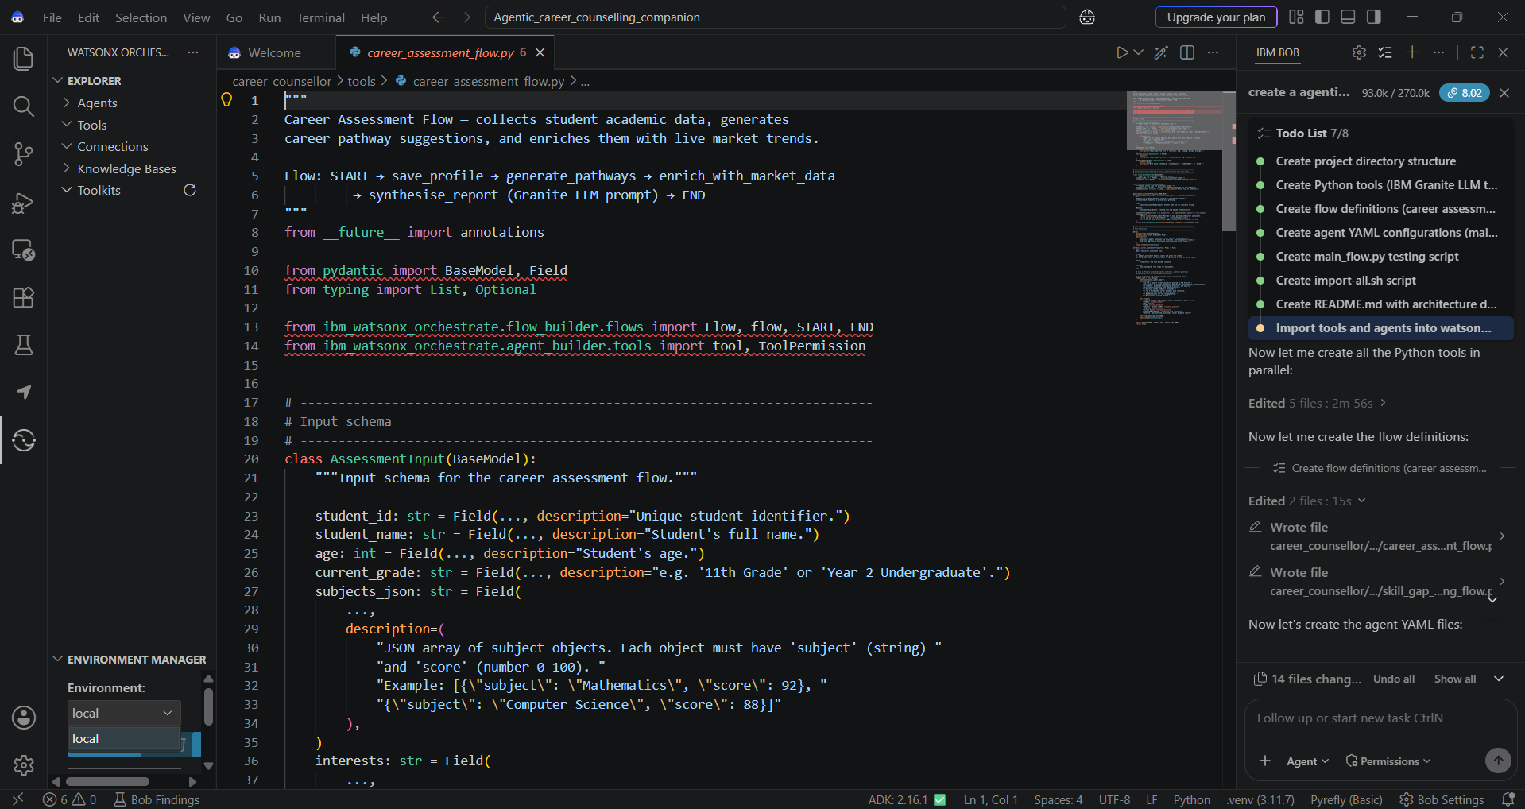

Slide 9
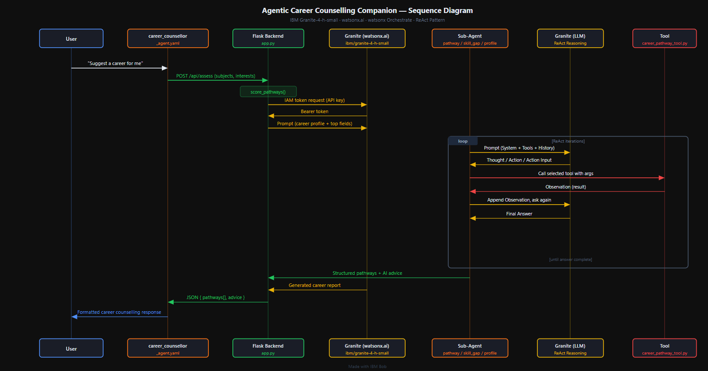
Architecture blueprint for IBM bob:

Slide 10

Role of Agentic AI in the solution
Role of Agentic AI in Career Counseling Companion
Agentic AI enables the Career Counseling Companion to function as an intelligent, autonomous system rather than a simple chatbot. Using IBM watsonx.ai and IBM Granite Models, it coordinates multiple specialized agents to deliver personalized career guidance.
Each agent performs a specific role—retrieving career information, recommending career paths, identifying skill gaps, and tracking student progress—while working together. This multi-agent approach ensures efficient task execution and accurate recommendations.
Agentic AI provides context awareness by understanding a student's academic performance, skills, interests, and career goals to generate tailored suggestions. It also supports real-time adaptation, continuously updating recommendations based on new achievements, certifications, and changing job market trends.
Overall, Agentic AI makes the system proactive, personalized, and goal-driven, acting like a smart digital career counselor that helps students make confident, future-ready career decisions.

Slide 11
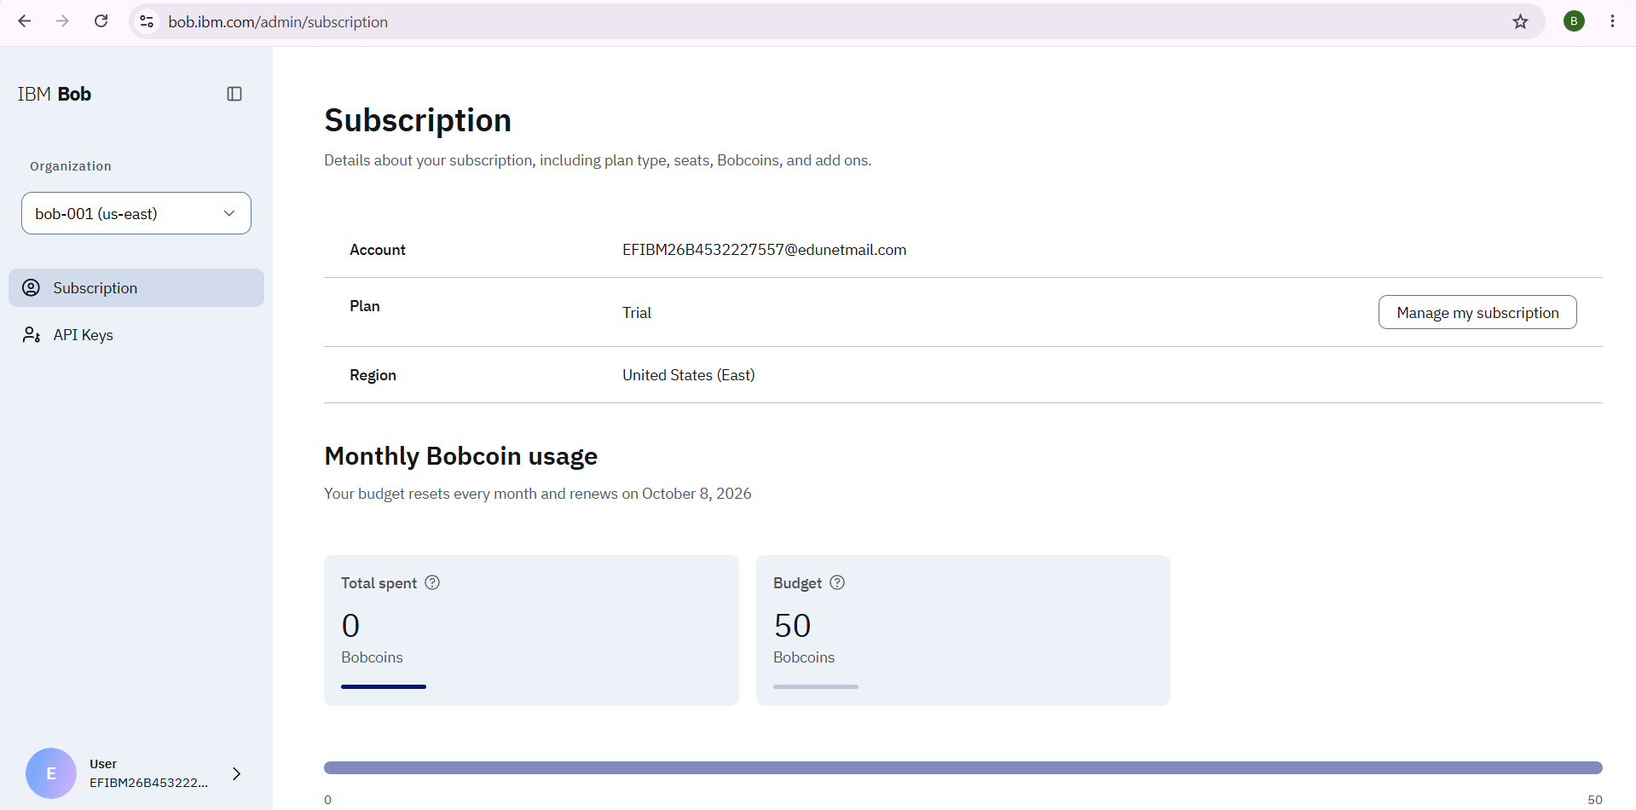
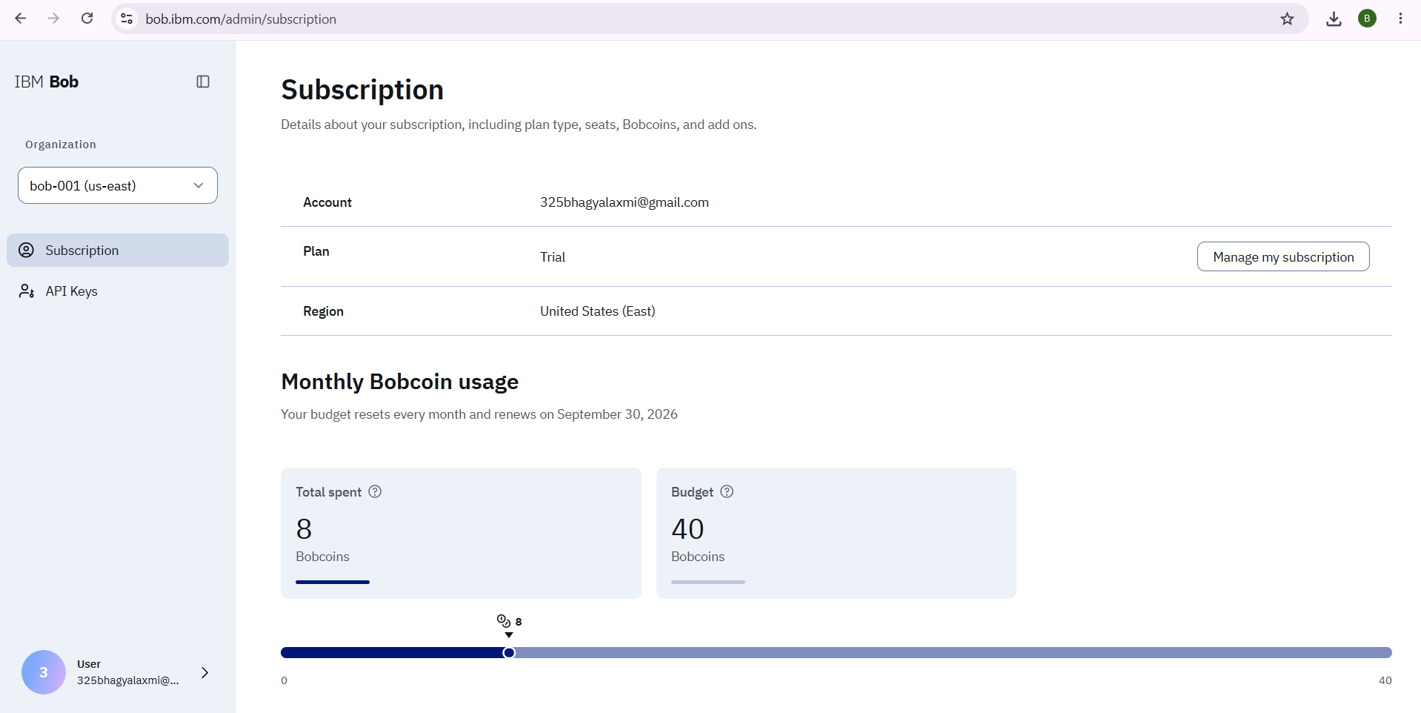

Token Usage
11,761 token are used
Before Prompt
After the Prompt
·
·
·

Slide 12
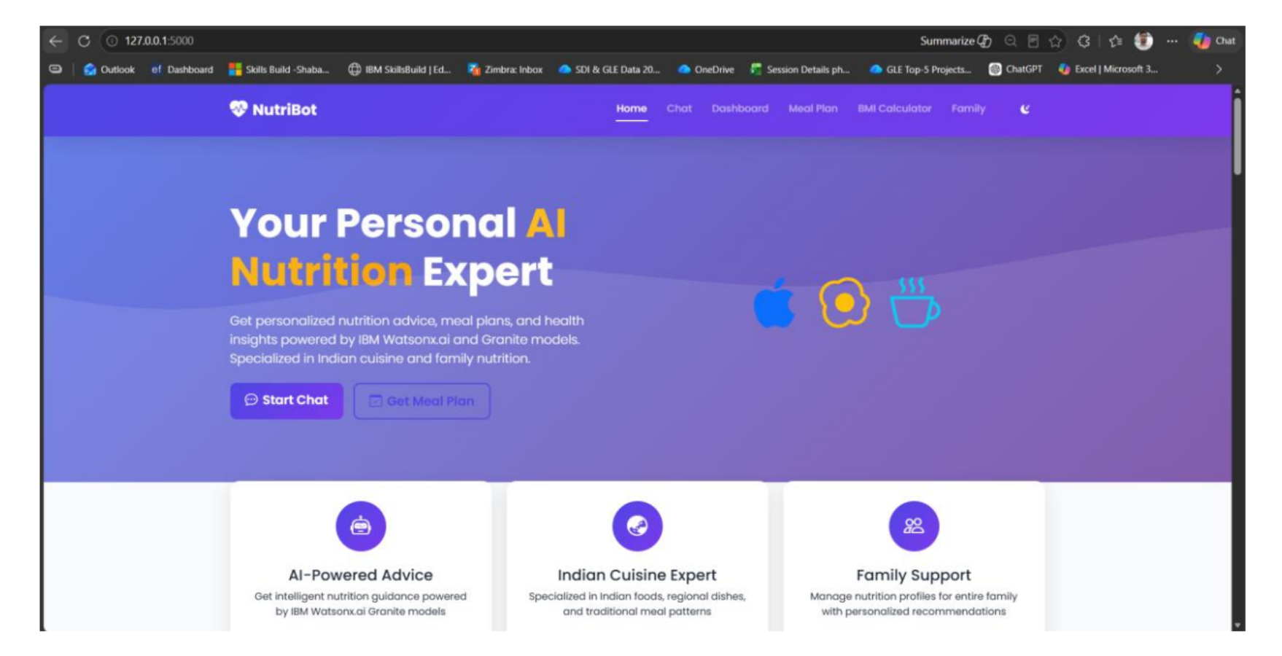
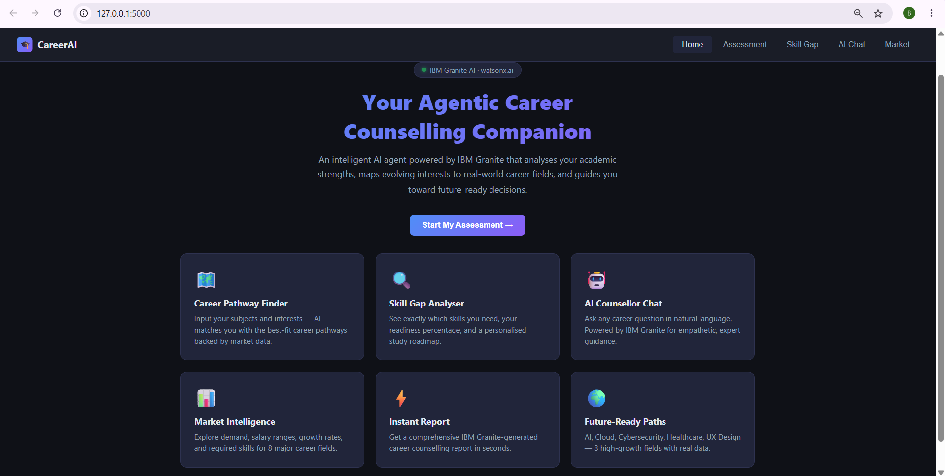
Project Output Screenshot
Please put IBM Bob output screenshots with 2-3 prompts.
You can take 2-3 more slides for each screenshot
·
·
·

Slide 13
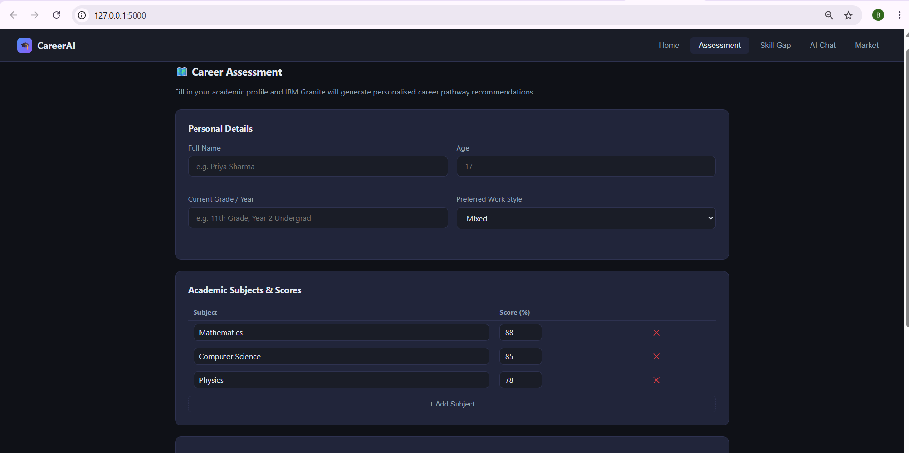
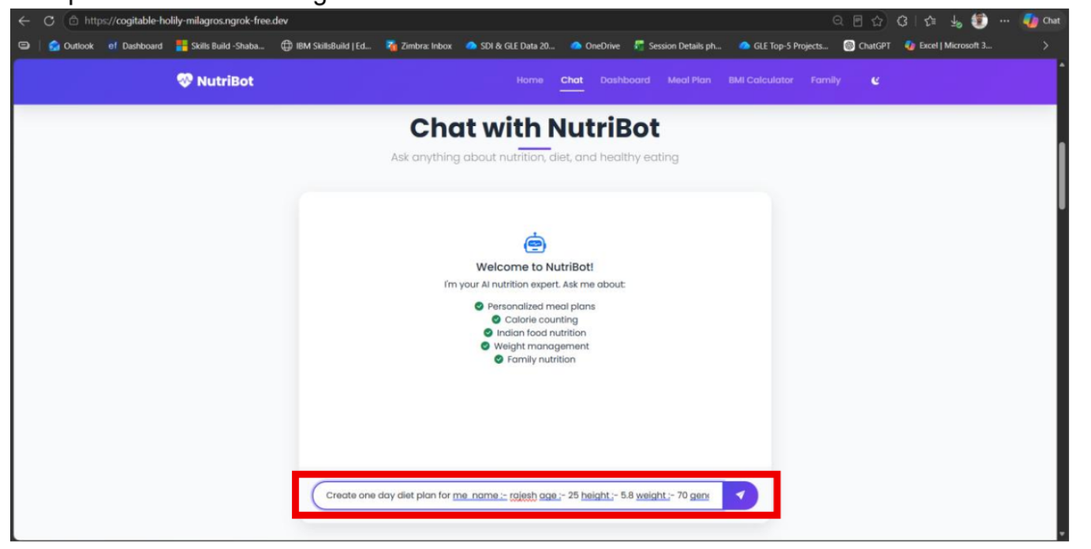
Project Output Screenshot
Please put IBM Bob output screenshots with 2-3 prompts.
You can take 2-3 more slides for each screenshot
·
·
·

Slide 14
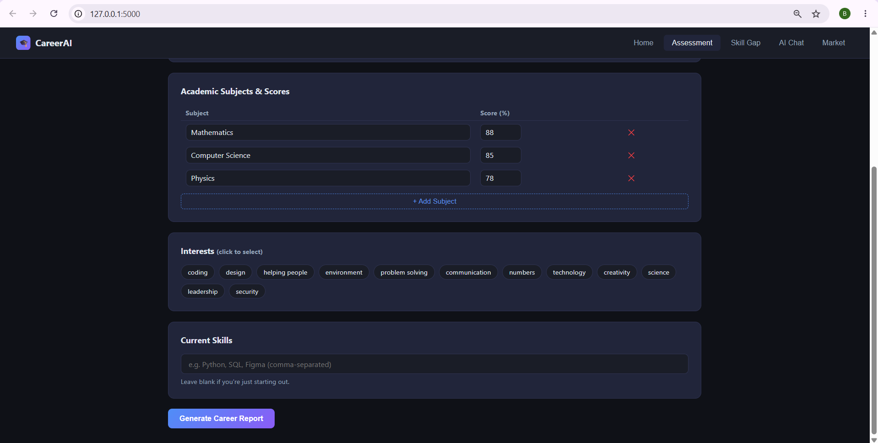
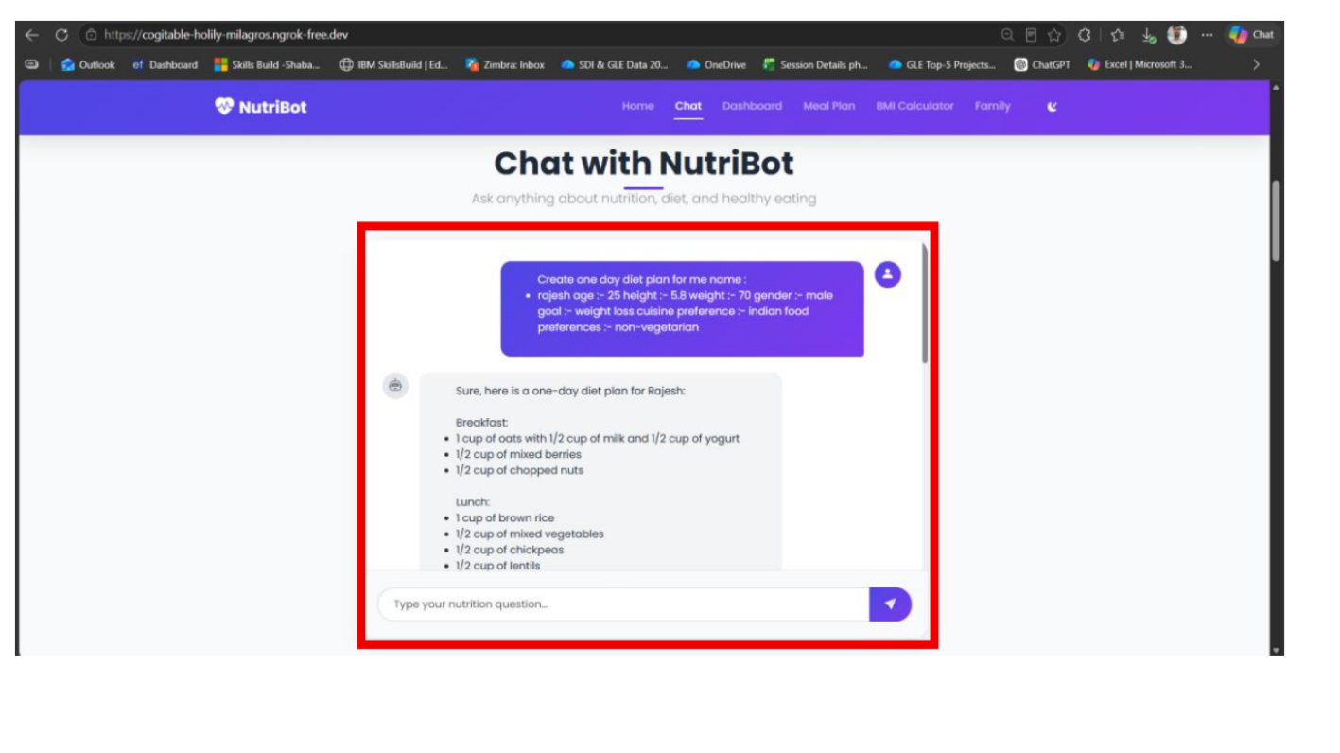
Project Output Screenshot
Please put IBM Bob output screenshots with 2-3 prompts.
You can take 2-3 more slides for each screenshot
·
·
·

Slide 15
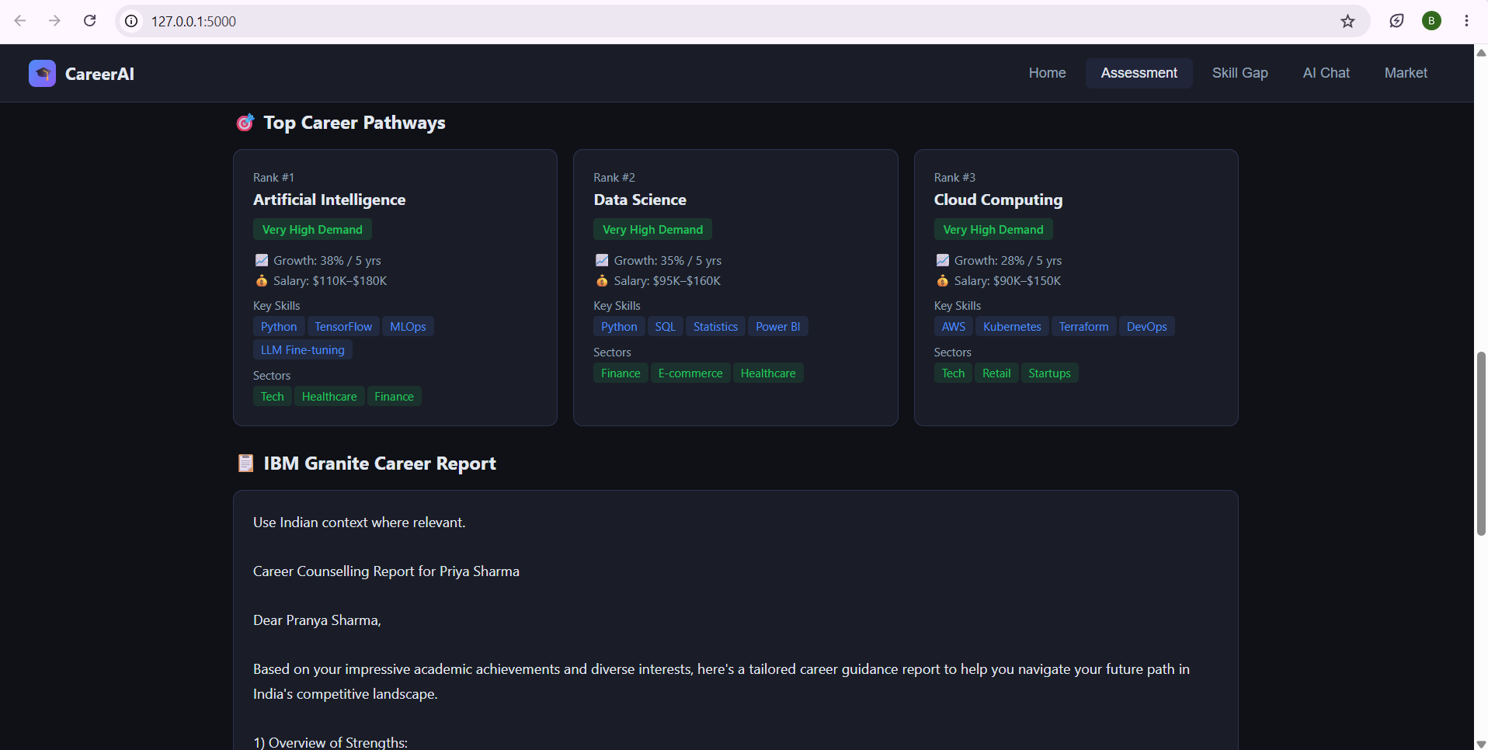
Project Output Screenshot

Slide 16
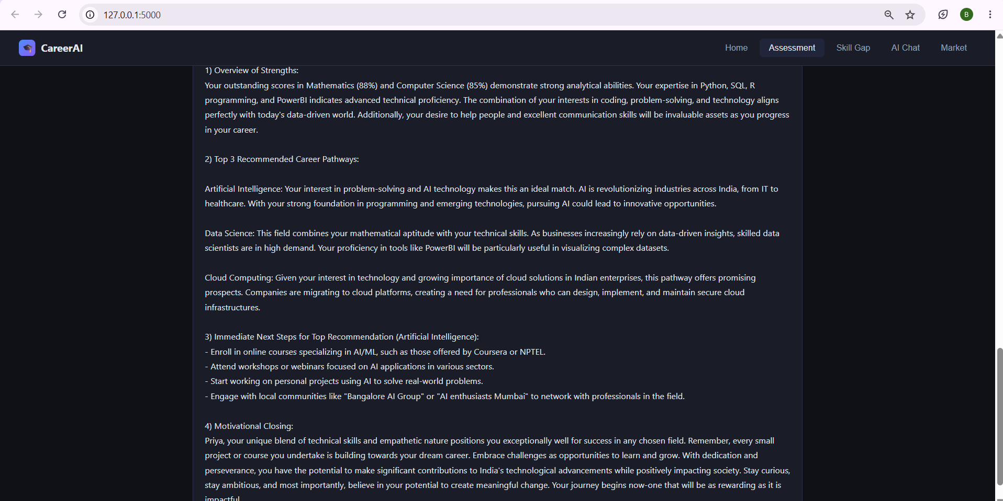
Project Output Screenshot

Slide 17
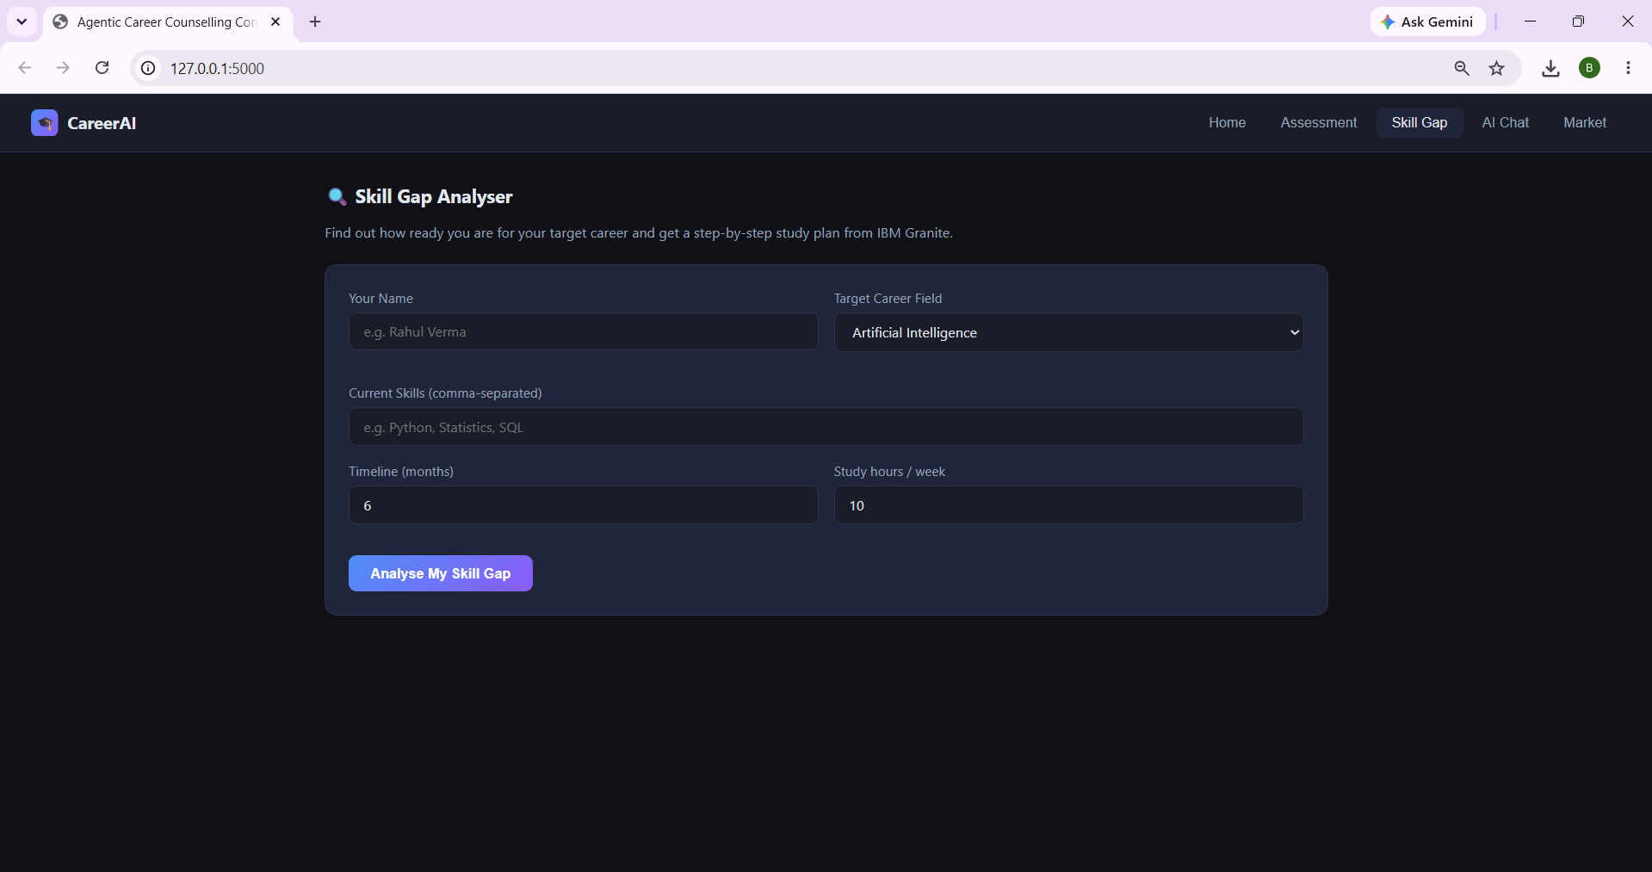
Project Output Screenshot

Slide 18
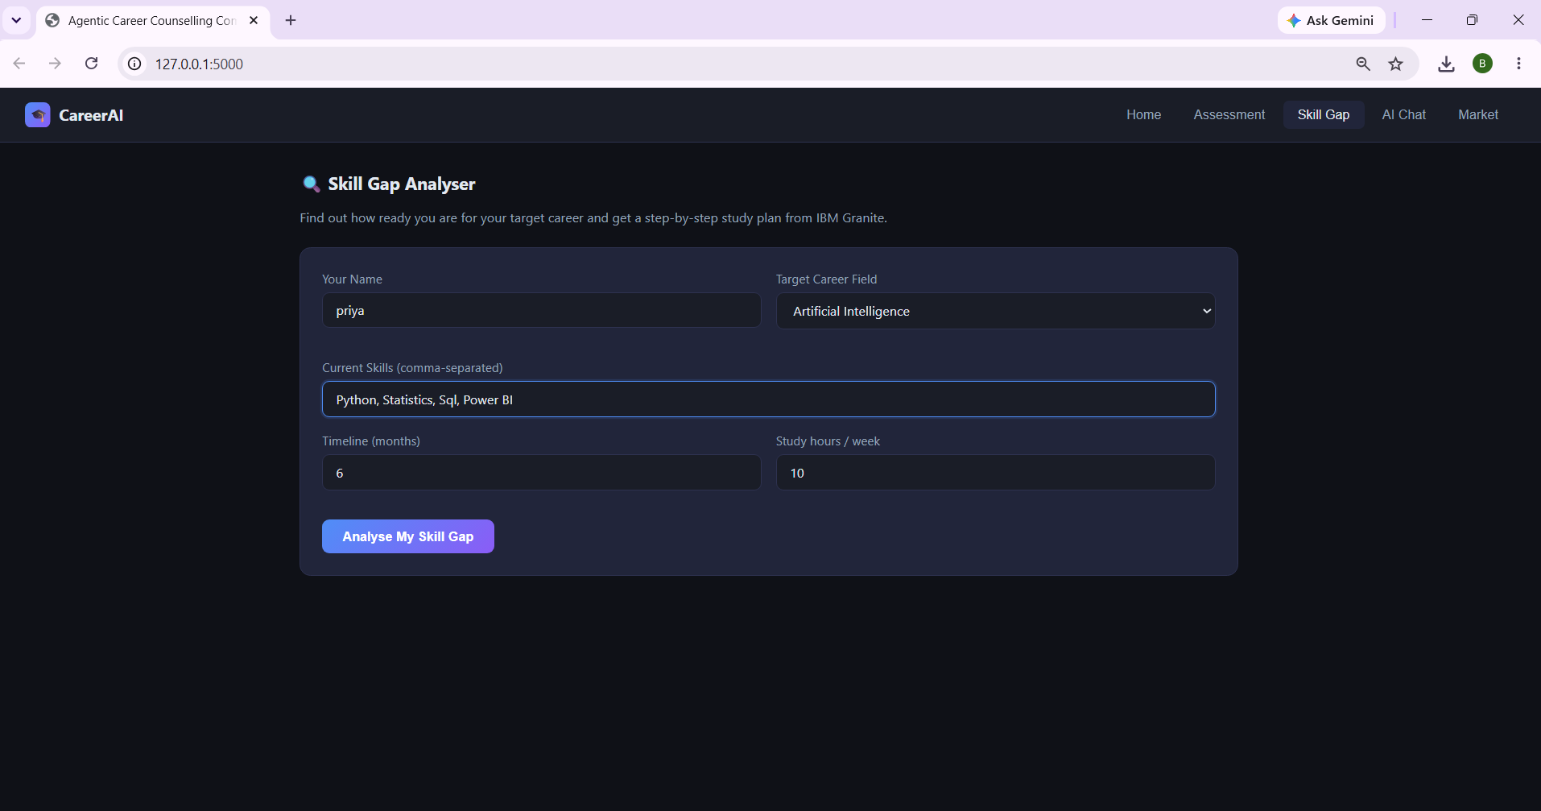
Project Output Screenshot

Slide 19
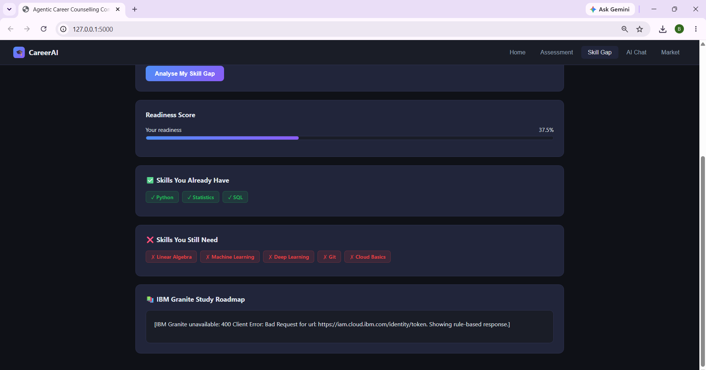
Project Output Screenshot

Slide 20
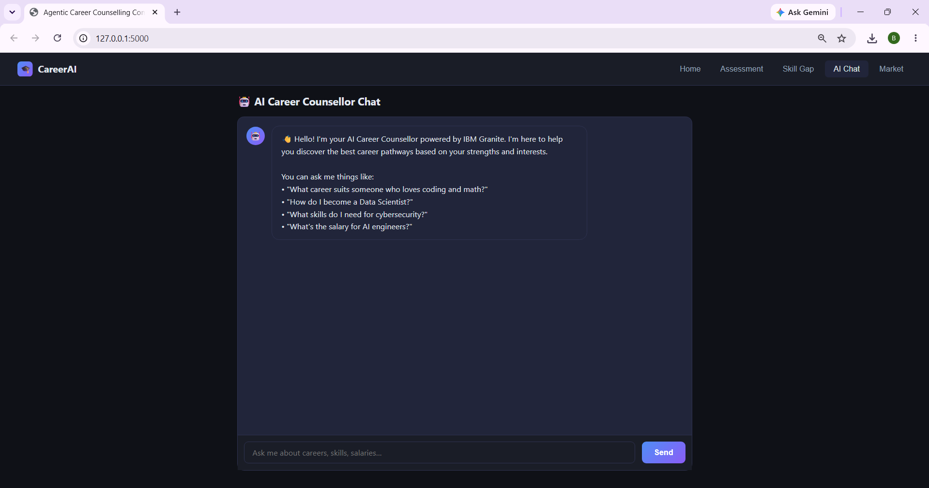
Project Output Screenshot

Slide 21
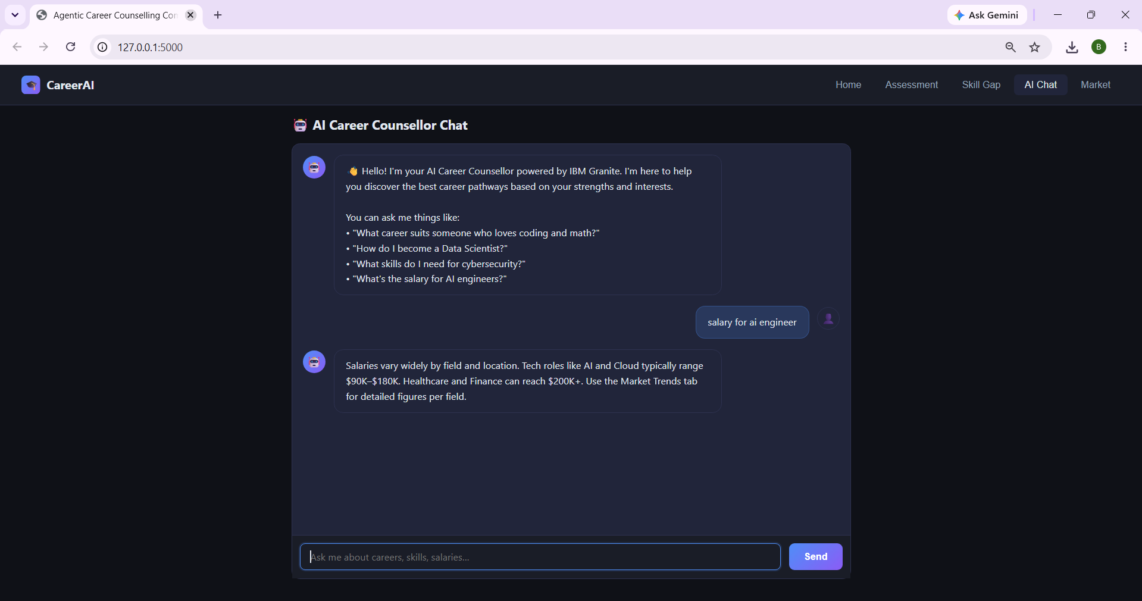
Project Output Screenshot

Slide 22
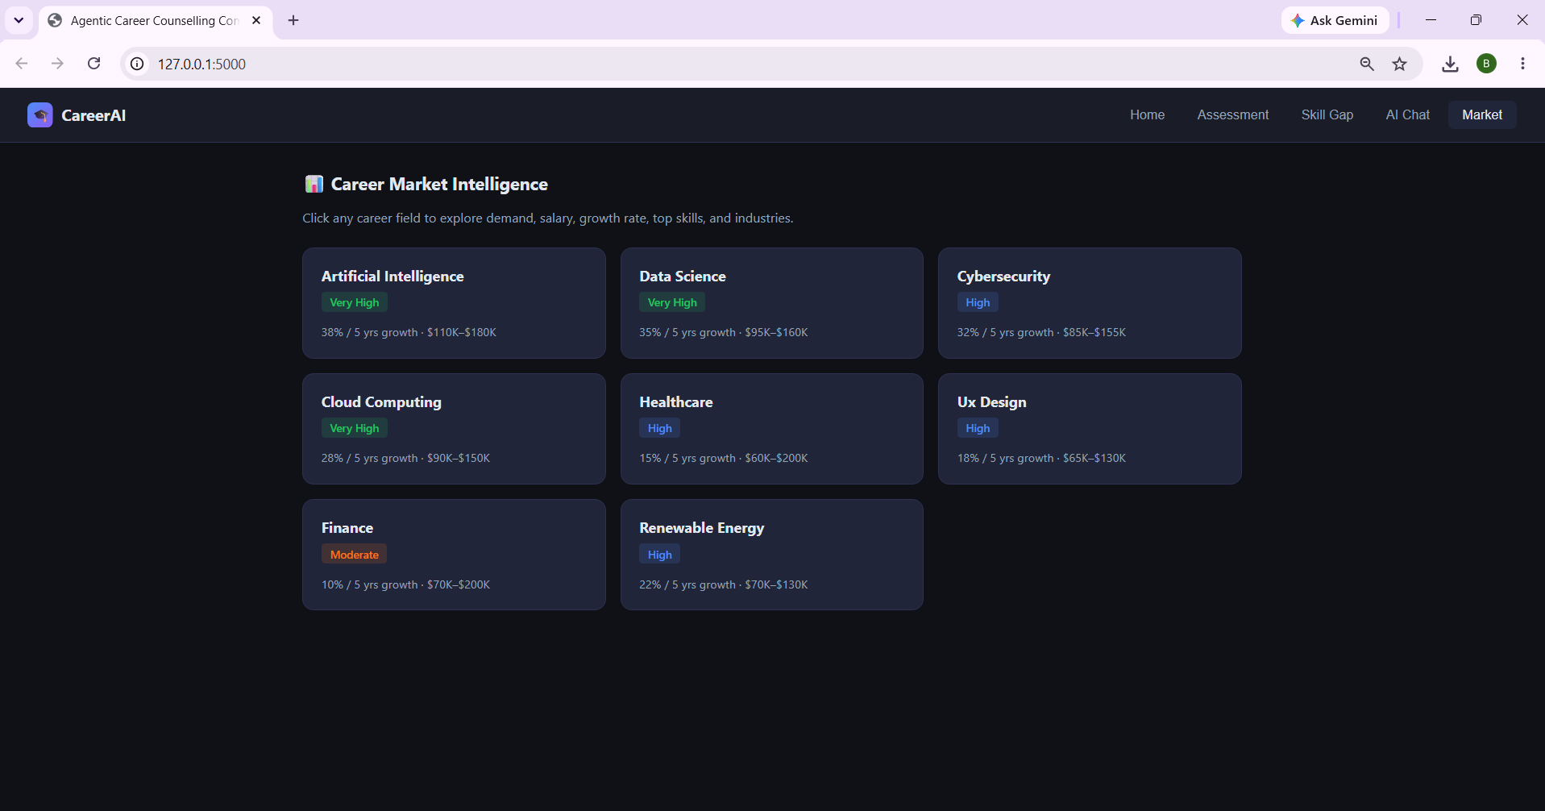
Project Output Screenshot

Slide 23
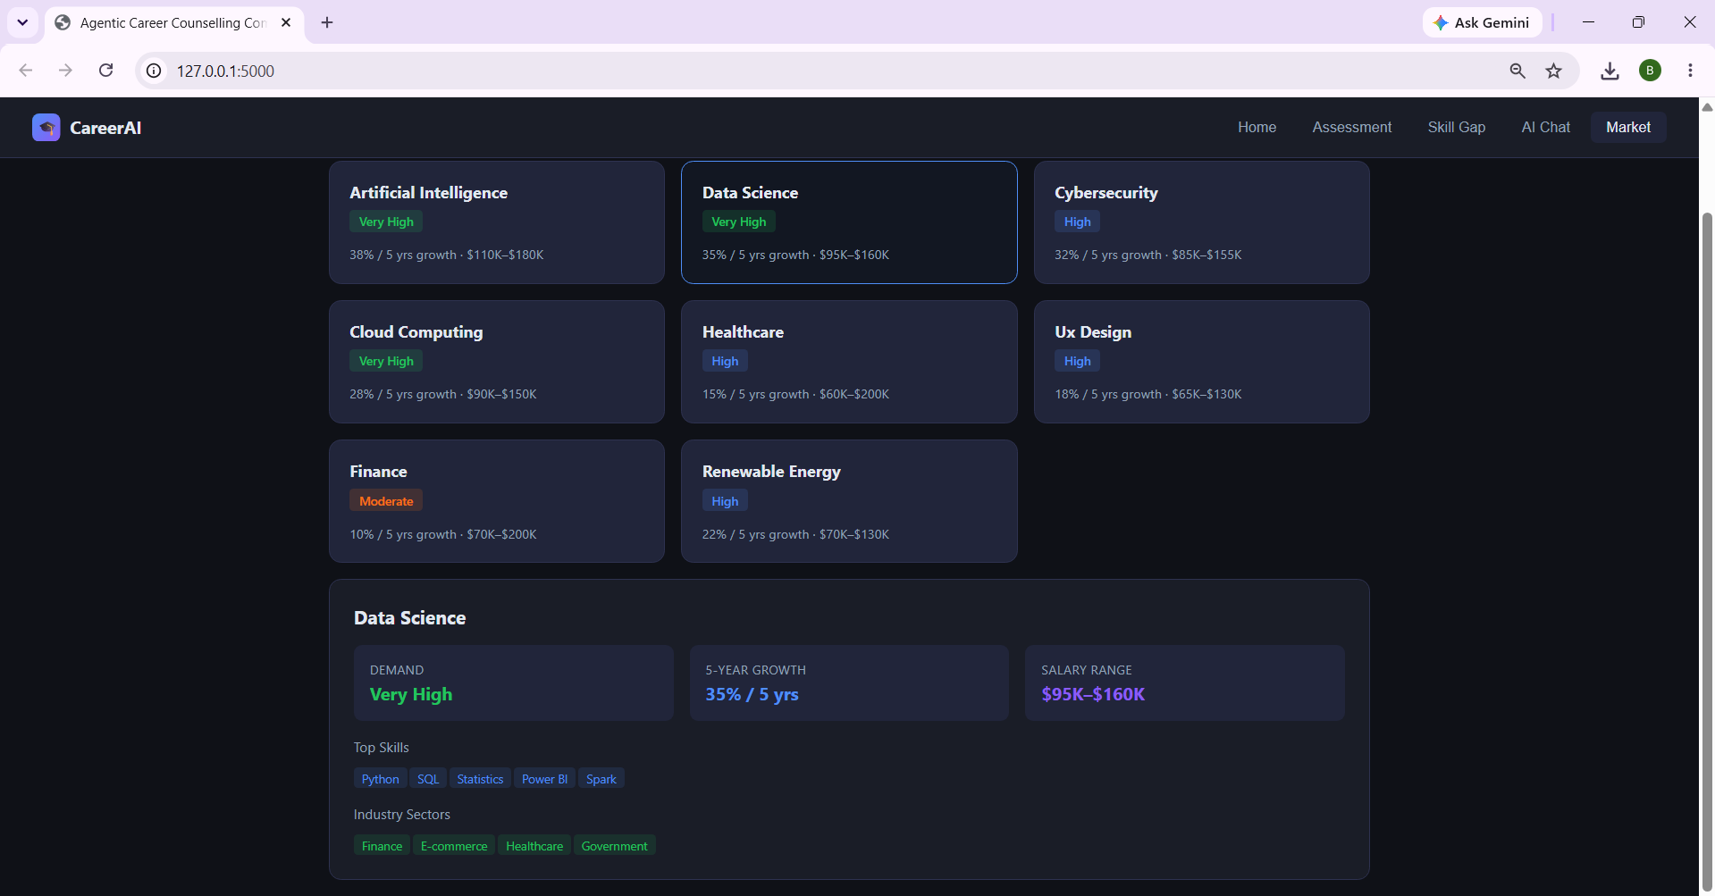
Project Output Screenshot

Slide 24
Novelty and Uniqueness
The proposed Agentic Career Counseling Companion stands out by combining Agentic AI, RAG, and personalization into a single intelligent career guidance system.
Multi-Agent Intelligence – Multiple specialized agents collaborate to provide accurate and context-aware career recommendations.
RAG-Based Accuracy – Combines real-time career data retrieval with AI-generated insights for reliable guidance.
Hyper-Personalization – Tailors career paths based on academic performance, skills, interests, and career goals.
Real-Time Adaption – Continuously updates recommendations as students gain new skills, certifications, and internships.
Skill Gap Analysis – Identifies missing skills and recommends relevant courses, projects, and certifications.
Scalable & Enterprise-Ready – Built on IBM watsonx.ai with IBM Granite models, ensuring reliability and governance.
This makes the solution a smart, adaptive, and proactive digital career counselor, not just a static career recommendation tool.

Slide 25
Git Hub Link
· Please create public github repository (Enable Add README button while creating repository) with format –
Please test and Paste the working Github URL – https://github.com/325bhagyalaxmi-lang/Agentic_career_counselling_companion
Make sure you have Uploaded following three files into your github repository 1) All Agent relevant files of IBM Cloud , 2) yourproblemstatement.pdf file 3) your projectpresntation.pptx file 4)any other files
·
·
·

Slide 26
Future Scope
1.Integration with Wearables & Health Devices –
The system can be integrated with smartwatches and fitness trackers to collect real-time data such as steps, calories burned, heart rate, and sleep patterns. This will enable the Nutrition Agent to provide more accurate and dynamic diet recommendations based on actual user activity and health metrics.
2.AI-Powered Voice Assistant & Multilingual Support –
Enhancing the system with a voice-enabled assistant and support for multiple languages will improve accessibility. Users can interact naturally in their preferred language, making the solution more inclusive and suitable for diverse populations, especially in regions with varied linguistic backgrounds.
·
·
·

Slide 27
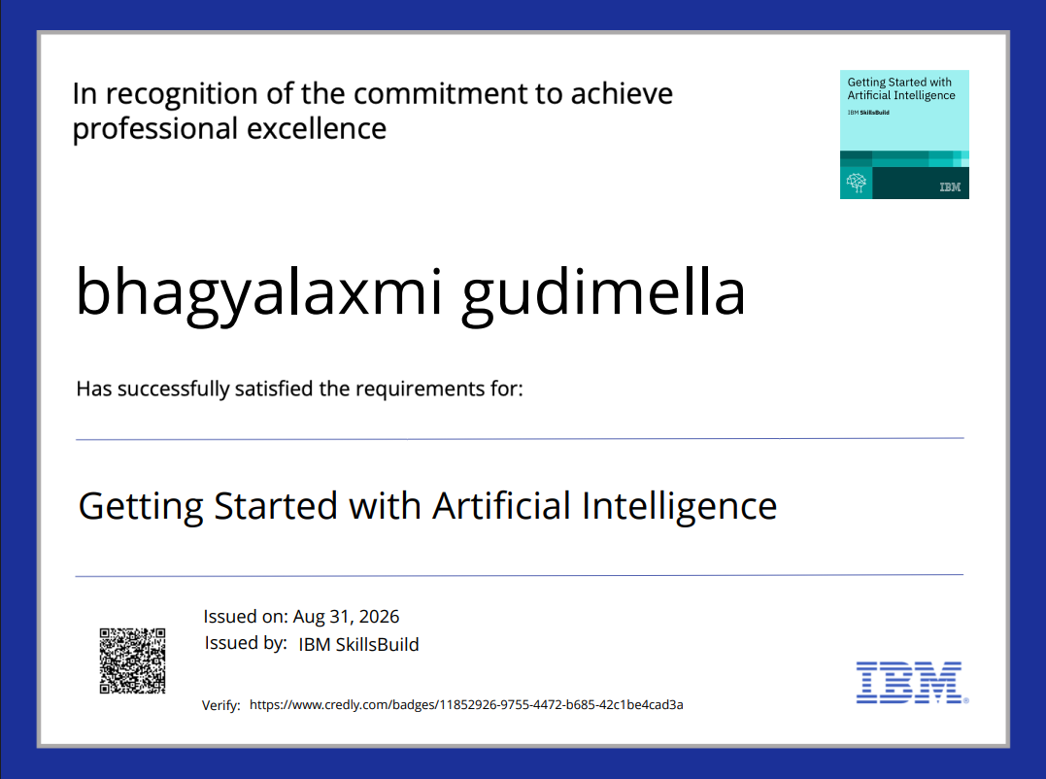
Certificates Earned:
Please add your credly certificate(Getting Started with Artificial Intelligence)

Slide 28
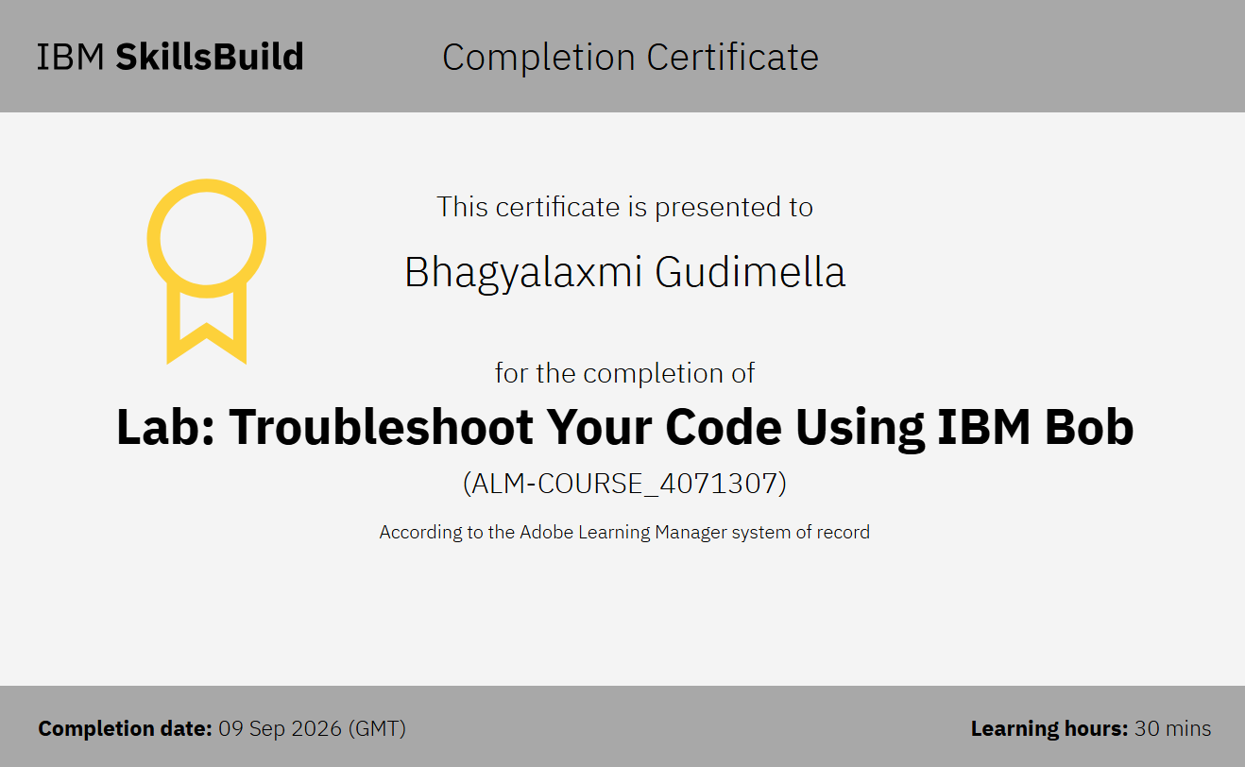
Certificates Earned:​
Add your IBM BOB Certificate

Slide 29


